Slide 1


MINI PROJECT.
Reverse engineering of missile launcher truck.

Slide 2
TEAM DETAILS
Name | USN | Roll no.
Abhishek Kulkarni | 01fe19bme139 | 144
Akash Tamate | 01fe19bme157 | 108
Vinay Kelur | 01fe19bme167 | 111
Prakhyath Nayak | 01fe19bme038 | 153
Harsha Kunnal | 01fe19bme040 | 102

Slide 3
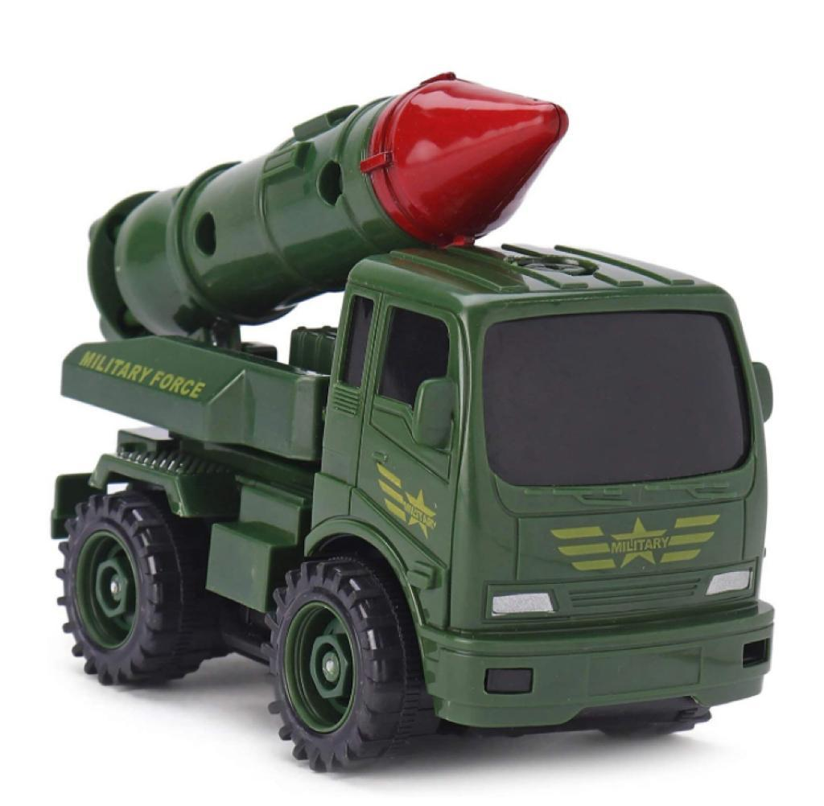
MISSILE LAUNCHER TRUCK
The model chosen for reverse engineering is missile launcher truck. The primary reason for choosing this is, the toy is constructable and the parts can be dismantled with ease. Other reason includes the complexity of the parts and unique design of few of the parts.

Slide 4
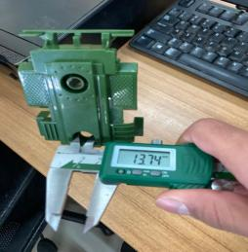
TOOLS USED FOR MEASUREMENT
1.Vernier caliper
Few of the components such as missile, upper
launchpad include holes that are hard to measure
using conventional measuring tools. Hence to
eliminate any intricate details the vernier calipers
is used. The usage of vernier calipers can be seen
in figure.

Slide 5
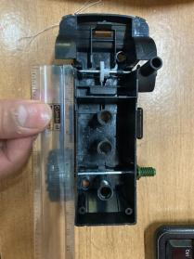
2. Measuring scale
The most conventional yet highly effective device
for measurement is the measuring scale. When the
measuring component is linear and easy to measure
the measuring scale is used.
Almost all the components of the product had the
usage of measuring scale.

Slide 6
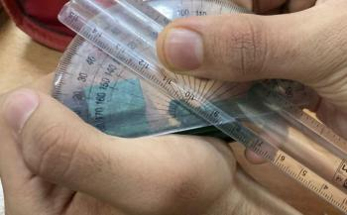
3. Protractor.
The protractor tool helps us measure an angle in
degrees. Few of the component designs were at
an angle such as missile’s toe and front end,
chassis’ backend, etc. To measure such design
complications protractor has been used.
The usage of the protractor can be seen in
figure.

Slide 7
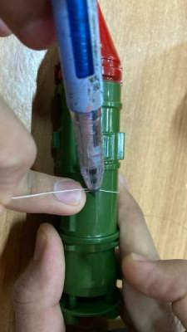
4.Thread
As far as the measuring is concerned, the thread is
not used vividly. The usage of the thread seems
uncanny yet very effective. When one cannot
measure the diameter of circles or holes in the
vicinity of the vernier calipers, the thread is used.
Thread gives the perimeter of the circle. By using
the formula, perimeter of the circle = 2πr one can
easily find the radius of the circle. The usage of
thread in finding the perimeter of the missile can be
seen in figure

Slide 8
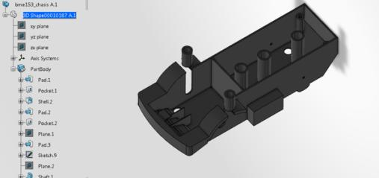
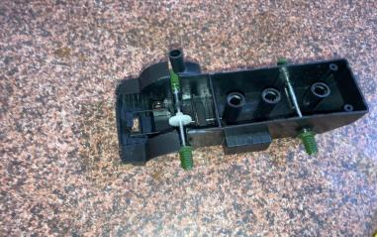
Component modelling
1. CHASIS

Slide 9
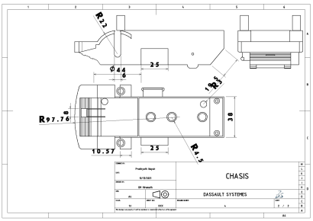
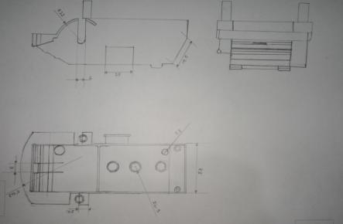
2D DRAWINGS

Slide 10
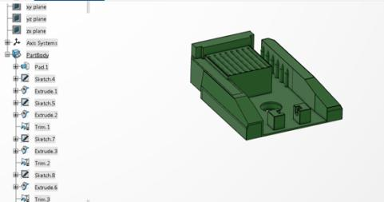
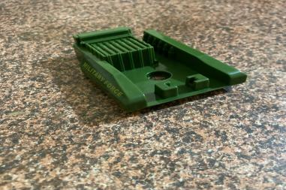
2. UPPER LAUNCHPAD

Slide 11
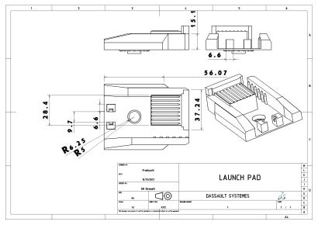
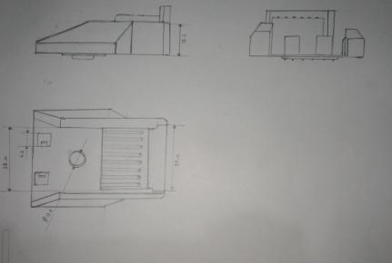
2D DRAWINGS

Slide 12
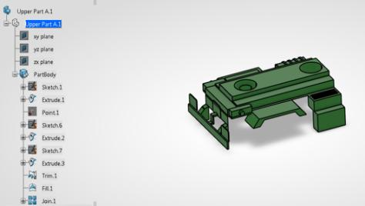
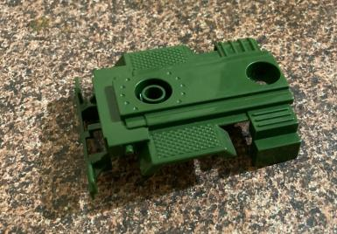
3. LAUNCHPAD

Slide 13
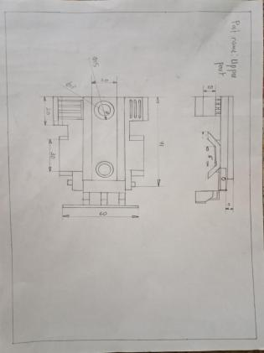
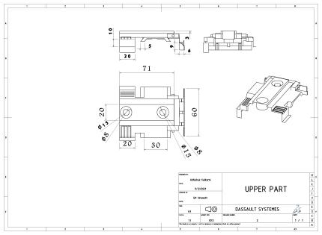
2D DRAWINGS

Slide 14
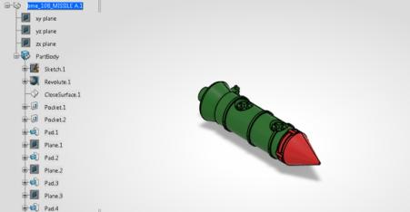
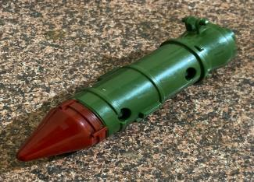
4. MISSILE

Slide 15
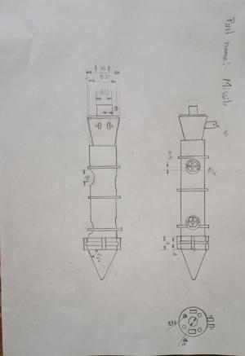
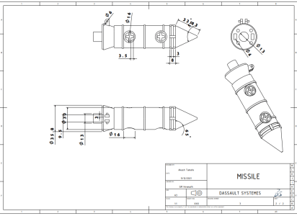
2D DRAWINGS

Slide 16
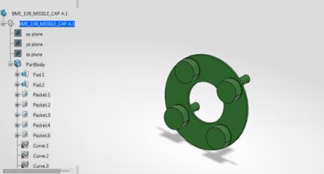
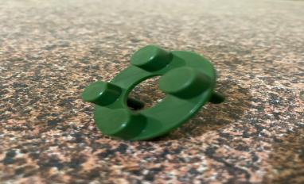
5. MISSILE CAP

Slide 17
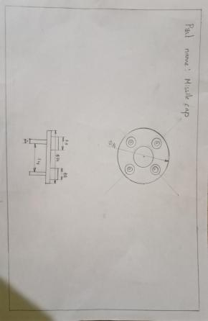
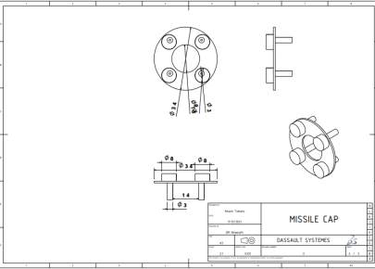
2D DRAWINGS

Slide 18
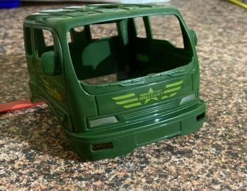
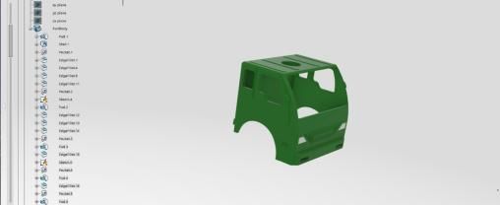
6. CABIN

Slide 19
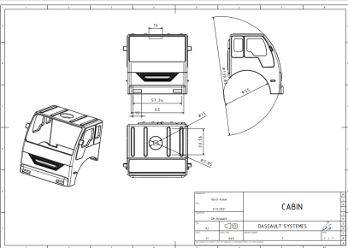
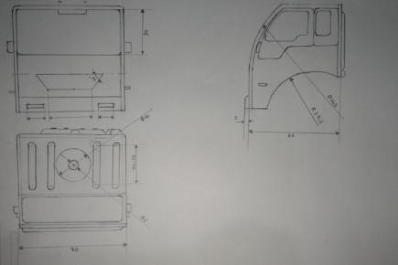
2D DRAWINGS

Slide 20
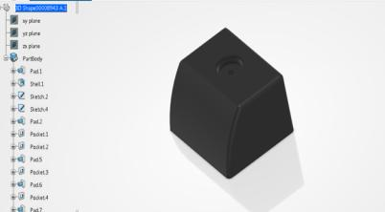
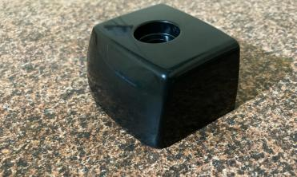
7. CABIN COMPONENT

Slide 21
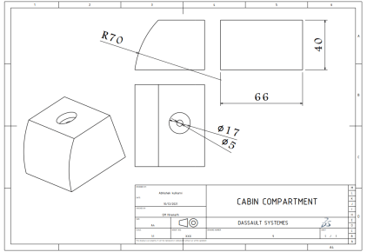
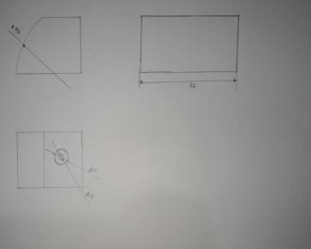
2D DRAWINGS

Slide 22
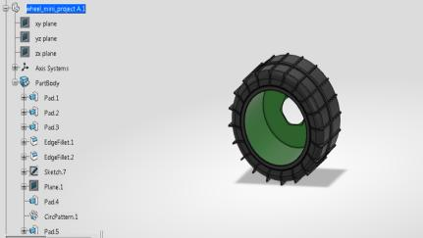
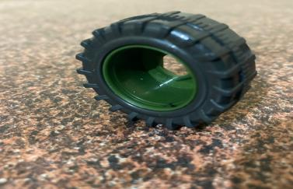
8. WHEEL

Slide 23
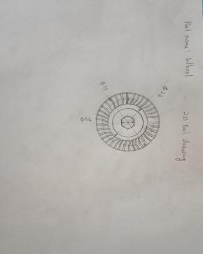
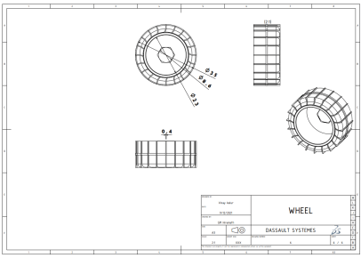
2D DRAWINGS

Slide 24
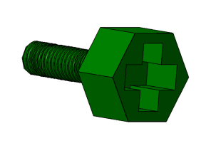
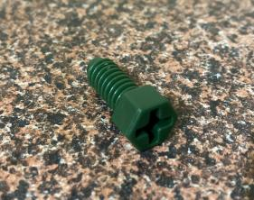
9. HEX BOLT

Slide 25
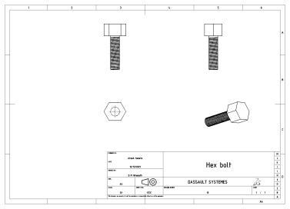
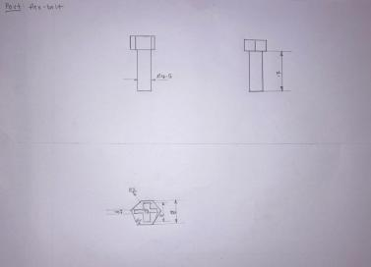
2D DRAWINGS

Slide 26
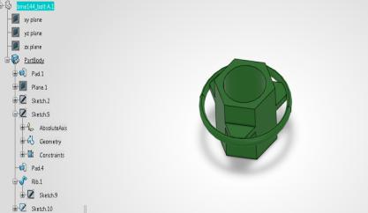
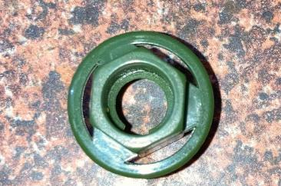
10. NUT

Slide 27
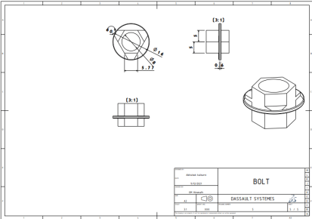
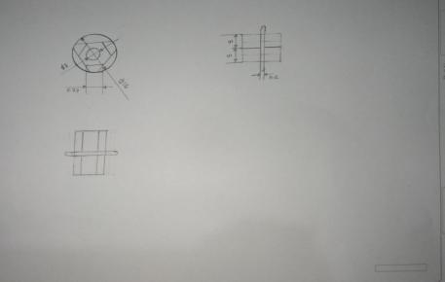
2D DRAWINGS

Slide 28
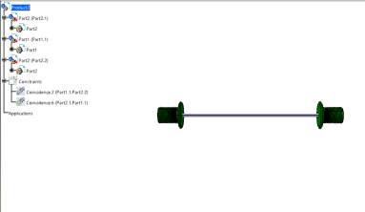
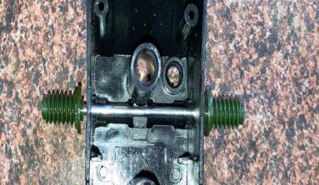
11. WHEEL AXLE

Slide 29
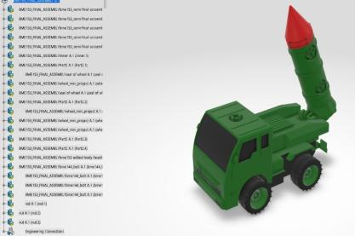
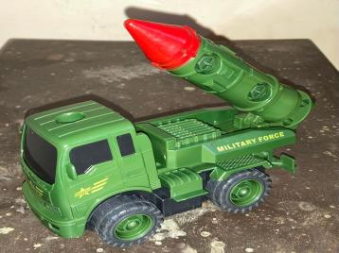
ASSEMBLY

Slide 30
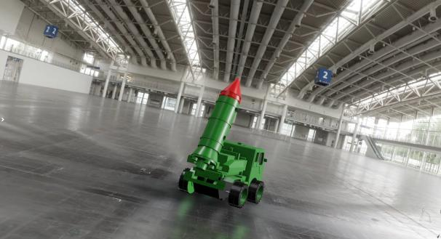
Assembly rendering video.

Slide 31

2D ASSEMBLY

Slide 32


EXPLODED VIEWS

Slide 33
THANK YOU

